Slide 1

2025 UBS Finance Challenge ~ Pair Trade Stock Pitch
Region：Hong Kong Stock Market
Sector：Industrial ( Automobile)
Prepared by Team of AlphaStock
Mr. Wen Jie (Menger)
The Chinese University of Hong Kong, Shenzhen (May 2027)
Mr. Fang Mingxiang (Jack)
Macalester College, USA (May 2028)

Slide 2


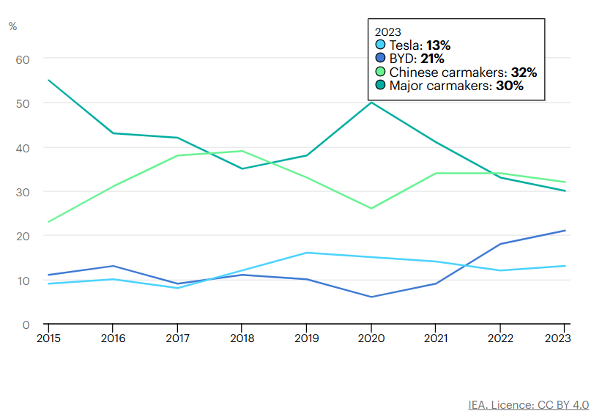
Overview of the EV Market and Pair Trade Concept and Key Assumption
Nearly one in five cars sold in 2023 was electric
BYD has over 30 industrial parks in China, the United States, Canada, Japan, Brazil, Hungary, and India. Its new energy vehicle footprint now covers 6 continents, over 70 countries and regions, and more than 400 cities

Slide 3
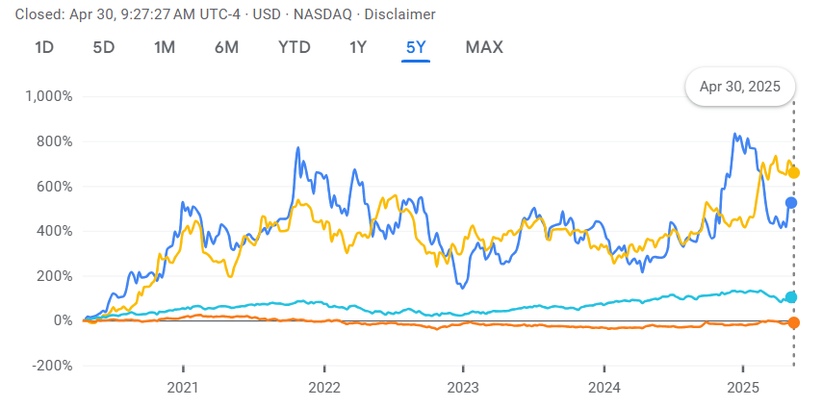


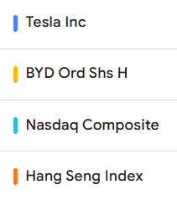
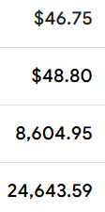
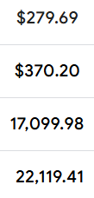
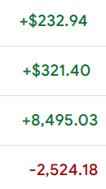
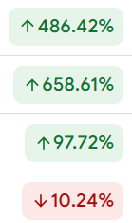
Past Five-year Trend of Pair Stock Prices vs. Index
5-yr Growth %

Slide 4
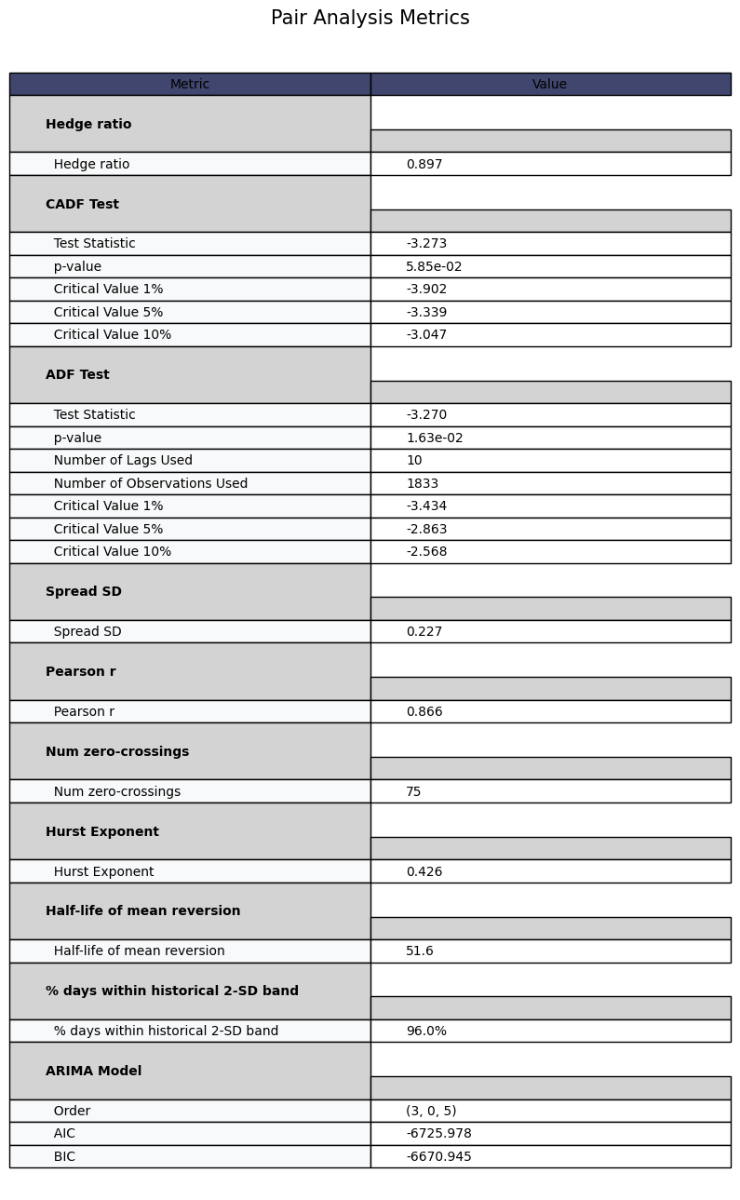
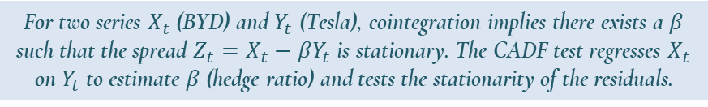

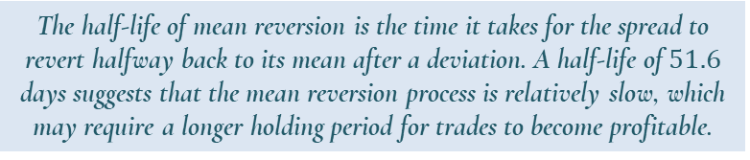
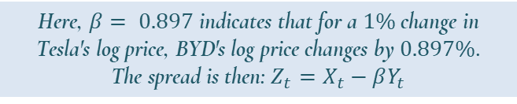

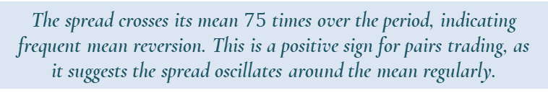
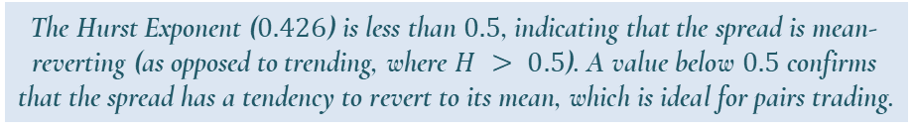
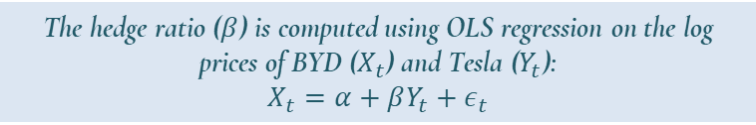
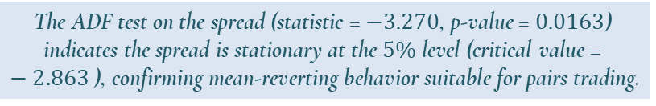
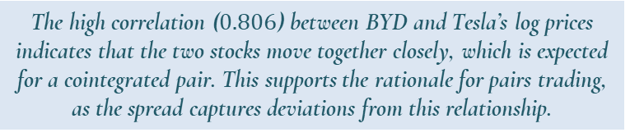
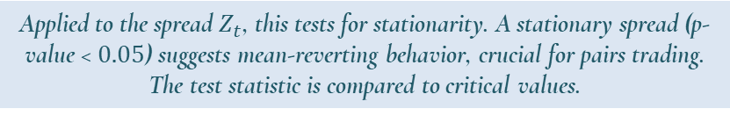
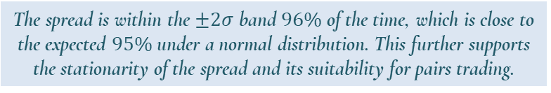
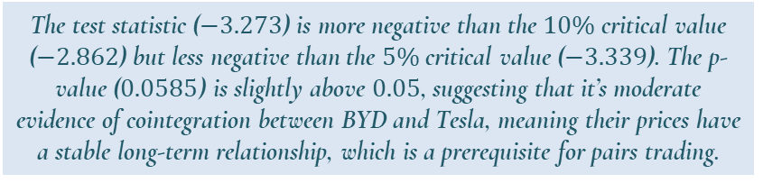
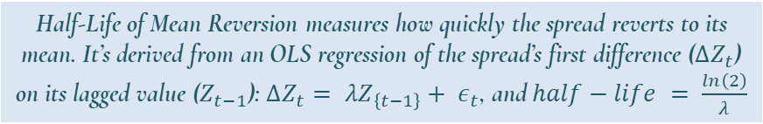
Quantitative Analysis: Use $log⁡$prices to stabilizes variance, convert to returns, ensure stationarity, handle multiplicative effects
Mathematical Explanation
Realistic Meaning
The hedge ratio ($β$) is computed using OLS regression on the log prices of BYD ($X_{t}$) and Tesla ($Y_{t}$):
$$X_{t}=α+βY_{t}+ε_{t}$$
Here, $β= 0.897$ indicates that for a $1\%$ change in Tesla's log price, BYD's log price changes by $0.897\%$.
The spread is then: $Z_{t}=X_{t}−βY_{t}$
The test statistic ($−3.273$) is more negative than the $10\%$ critical value ($−2.862$) but less negative than the $5\%$ critical value ($−3.339$). The p-value ($0.0585$) is slightly above $0.05$, suggesting that it’s moderate evidence of cointegration between BYD and Tesla, meaning their prices have a stable long-term relationship, which is a prerequisite for pairs trading.
For two series $X_{t}$ (BYD) and $Y_{t}$ (Tesla), cointegration implies there exists a $β$ such that the spread $Z_{t}=X_{t}−βY_{t}$ is stationary. The CADF test regresses $X_{t}$ on $Y_{t}$ to estimate $β$ (hedge ratio) and tests the stationarity of the residuals.
Applied to the spread $Z_{t}$, this tests for stationarity. A stationary spread (p-value < $0.05$) suggests mean-reverting behavior, crucial for pairs trading. The test statistic is compared to critical values.
The ADF test on the spread (statistic = $−3.270$, p-value = $0.0163$) indicates the spread is stationary at the $5\%$ level (critical value = $−2.863$), confirming mean-reverting behavior suitable for pairs trading.
$$r=\frac{∑\left(x_{i}−\overline{x}\right)\left(y_{i}− \overline{y}\right)}{\sqrt{∑{\left(x_{i}− \overline{x}\right)}^{2}∑{\left(y_{i}− \overline{y}\right)}^{2}}}$$
Pearson Correlation measures the linear relationship between the two stocks’ log prices.
The high correlation ($0.806$) between BYD and Tesla’s log prices indicates that the two stocks move together closely, which is expected for a cointegrated pair. This supports the rationale for pairs trading, as the spread captures deviations from this relationship.
The spread crosses its mean $75$ times over the period, indicating frequent mean reversion. This is a positive sign for pairs trading, as it suggests the spread oscillates around the mean regularly.
The Hurst Exponent $H$ measures the degree of long-term memory in a time series:
$H < 0.5$: Mean-reverting series
$H = 0.5$: Random walk
$H > 0.5$: Trending series
The Hurst Exponent ($0.426$) is less than $0.5$, indicating that the spread is mean-reverting (as opposed to trending, where $H > 0.5$). A value below $0.5$ confirms that the spread has a tendency to revert to its mean, which is ideal for pairs trading.
Half-Life of Mean Reversion measures how quickly the spread reverts to its mean. It’s derived from an OLS regression of the spread’s first difference ($ΔZ_{t}$) on its lagged value ($Z_{t−1}$): $ΔZ_{t}= λZ_{\left\{t−1\right\}}+ ε_{t}$, and $half−life = \frac{ln\left(2\right)}{λ}$
The half-life of mean reversion is the time it takes for the spread to revert halfway back to its mean after a deviation. A half-life of $51.6$ days suggests that the mean reversion process is relatively slow, which may require a longer holding period for trades to become profitable.
The spread is within the $±2σ$ band $96\%$ of the time, which is close to the expected $95\%$ under a normal distribution. This further supports the stationarity of the spread and its suitability for pairs trading.

Slide 5
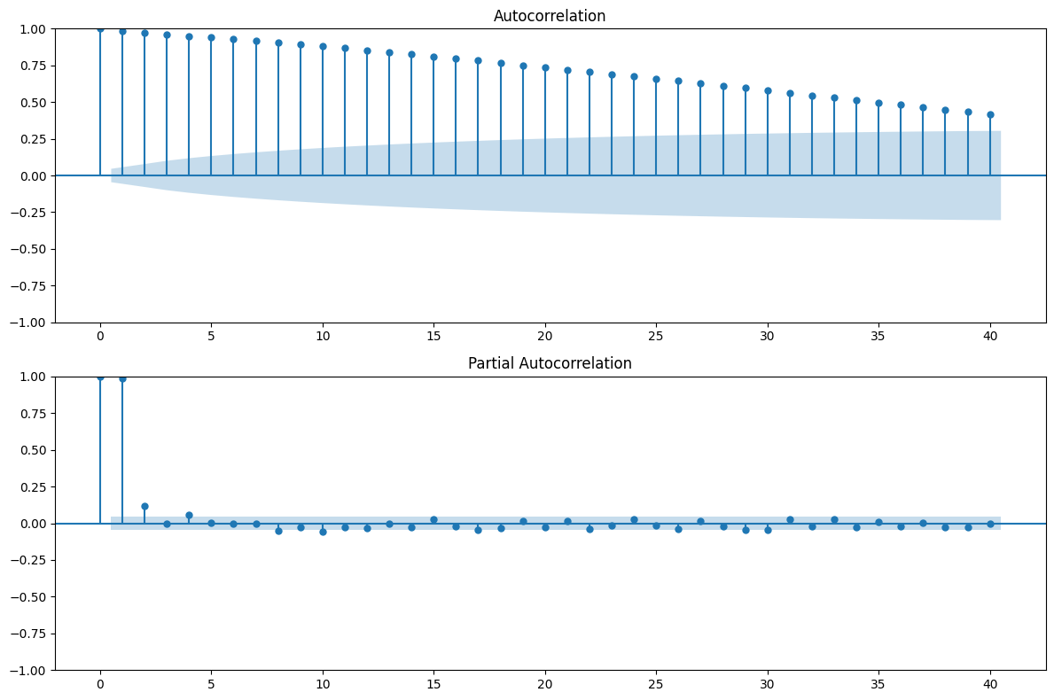
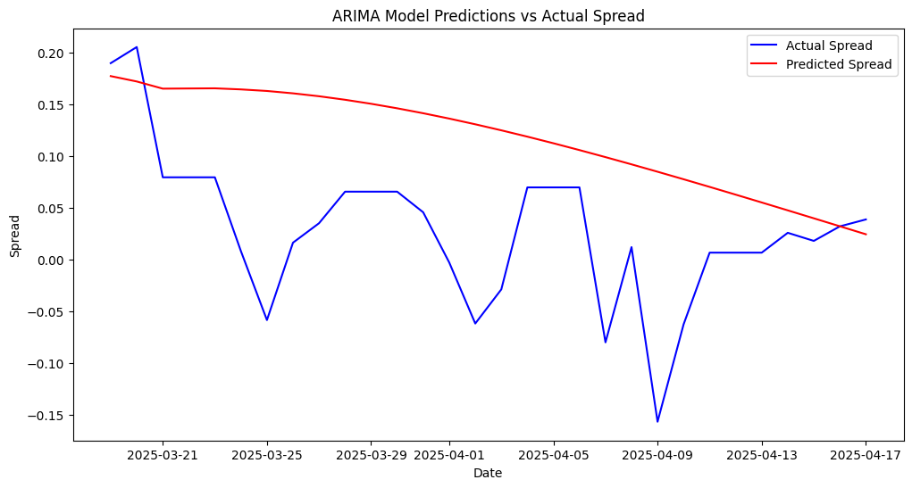
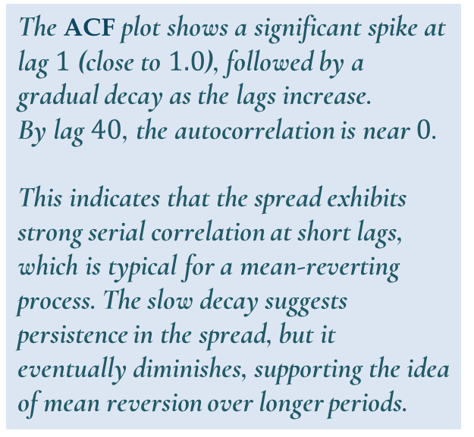
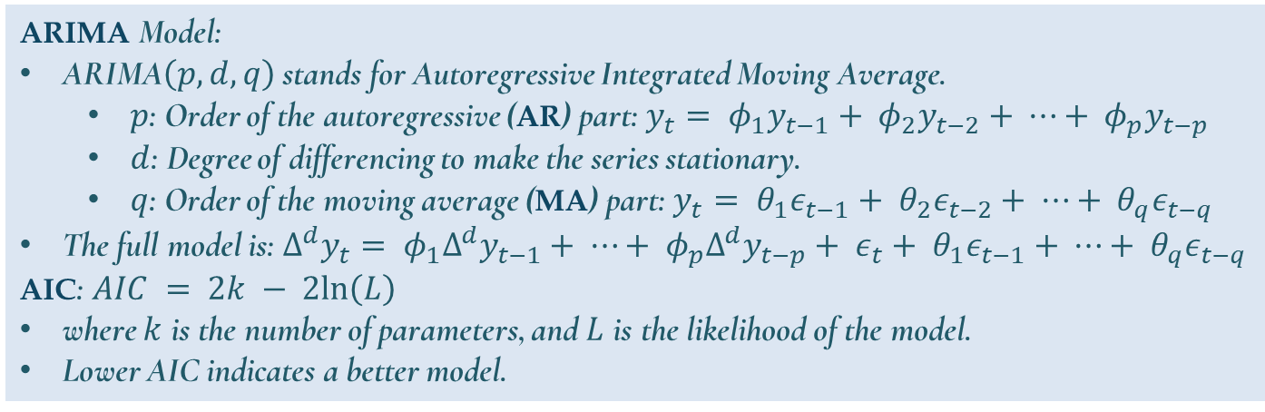
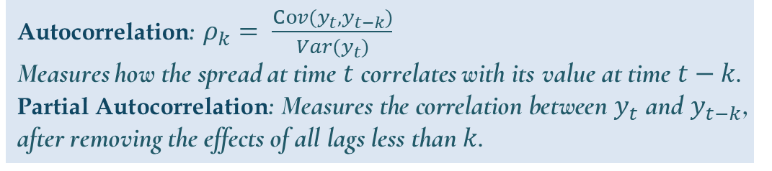
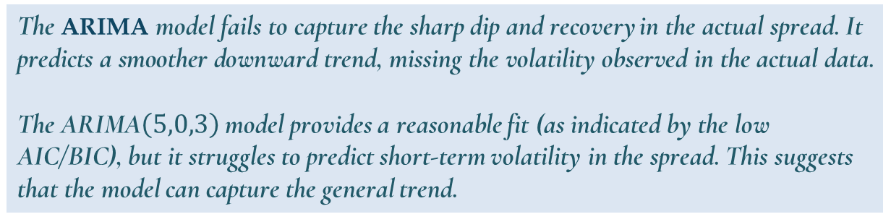

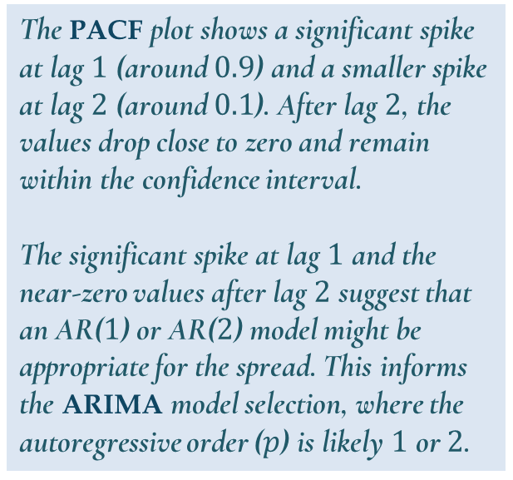
Quantitative Analysis: ARIMA Model
Autocorrelation: $ρ_{k}= \frac{Cov(y_{t}, y_{t−k})}{Var(y_{t})}$
Measures how the spread at time $t$ correlates with its value at time $t−k$.
Partial Autocorrelation: Measures the correlation between $y_{t}$ and $y_{t−k}$, after removing the effects of all lags less than $k$.
ARIMA Model:
ARIMA$\left(p, d, q\right)$ stands for Autoregressive Integrated Moving Average.
  $p$: Order of the autoregressive (AR) part: $y_{t}= φ_{1}y_{t−1}+ φ_{2}y_{t−2}+ ⋯+ φ_{p}y_{t−p}$
  $d$: Degree of differencing to make the series stationary.
  $q$: Order of the moving average (MA) part: $y_{t}= θ_{1}ε_{t−1}+ θ_{2}ε_{t−2}+ ⋯+ θ_{q}ε_{t−q}$
The full model is: $Δ^{d}y_{t}= φ_{1}Δ^{d}y_{t−1}+ ⋯+ φ_{p}Δ^{d}y_{t−p}+ ε_{t}+ θ_{1}ε_{t−1}+ ⋯+ θ_{q}ε_{t−q}$
AIC: $AIC = 2k − 2ln\left(L\right)$
where $k$ is the number of parameters, and $L$ is the likelihood of the model.
Lower AIC indicates a better model.
The ACF plot shows a significant spike at lag $1$ (close to $1.0$), followed by a gradual decay as the lags increase.
By lag $40$, the autocorrelation is near $0$.
This indicates that the spread exhibits strong serial correlation at short lags, which is typical for a mean-reverting process. The slow decay suggests persistence in the spread, but it eventually diminishes, supporting the idea of mean reversion over longer periods.
The PACF plot shows a significant spike at lag $1$ (around $0.9$) and a smaller spike at lag $2$ (around $0.1$). After lag $2$, the values drop close to zero and remain within the confidence interval.
The significant spike at lag $1$ and the near-zero values after lag $2$ suggest that an AR($1$) or AR($2$) model might be appropriate for the spread. This informs the ARIMA model selection, where the autoregressive order ($p$) is likely $1$ or $2$.
The ARIMA model fails to capture the sharp dip and recovery in the actual spread. It predicts a smoother downward trend, missing the volatility observed in the actual data.
The ARIMA$\left(5,0,3\right)$ model provides a reasonable fit (as indicated by the low AIC/BIC), but it struggles to predict short-term volatility in the spread. This suggests that the model can capture the general trend.
$∴$The ACF and PACF plots confirm that the spread has a mean-reverting nature with a strong AR($1$) component, which is promising for pairs trading.

Slide 6
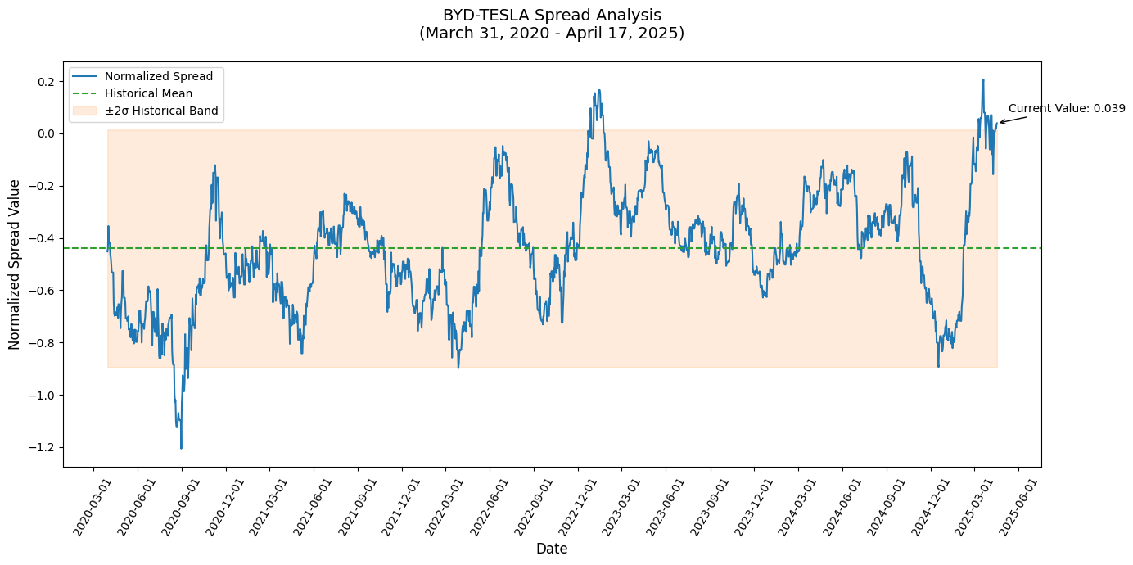
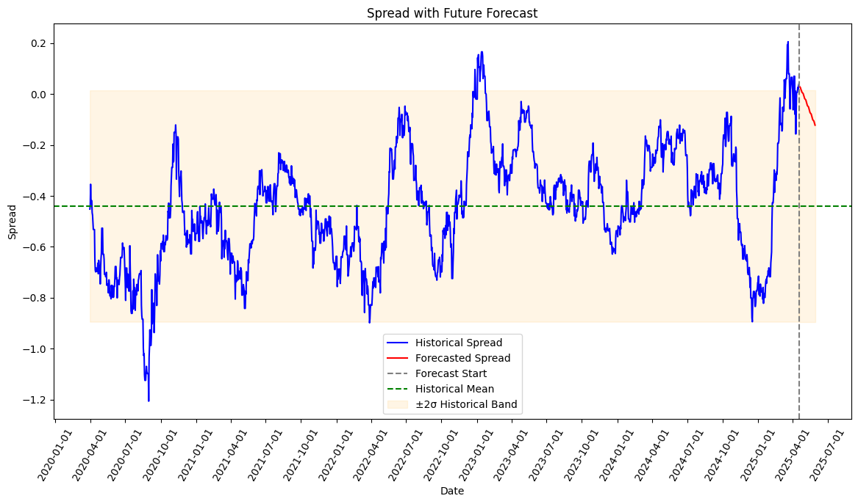
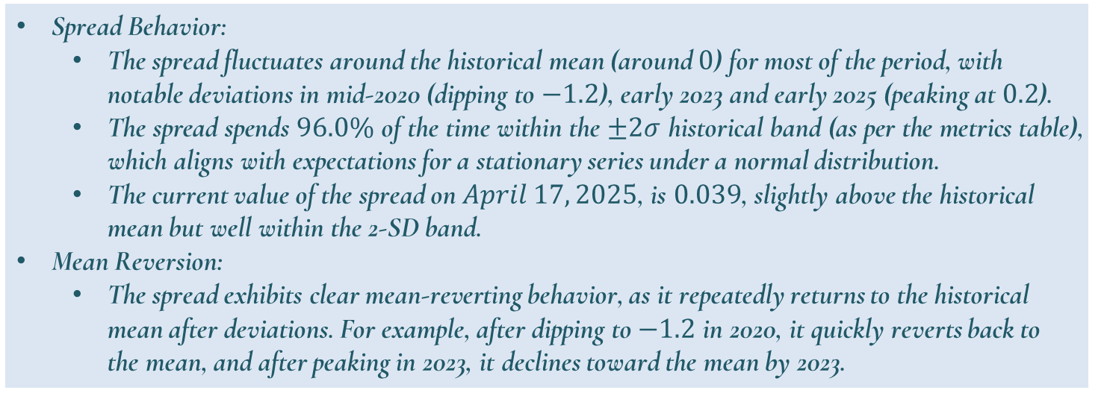
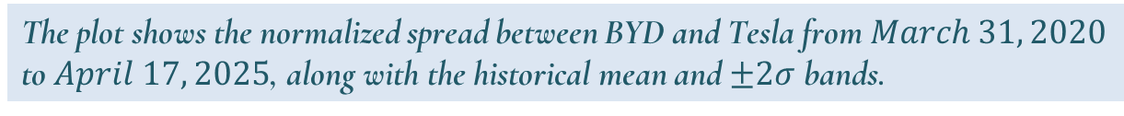
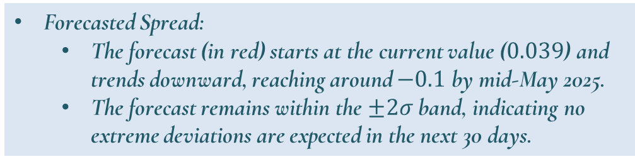
Quantitative Analysis: Spread Analysis & Forecast
The plot shows the normalized spread between BYD and Tesla from $March 31, 2020$ to $April 17, 2025$, along with the historical mean and $±2σ$ bands.
The plot shows the historical spread with a 30-day forecast starting from $April 17, 2025$.
Spread Behavior:
  The spread fluctuates around the historical mean (around $0$) for most of the period, with notable deviations in mid-2020 (dipping to $−1.2$), early 2023 and early 2025 (peaking at $0.2$).
  The spread spends $96.0\%$ of the time within the $±2σ$ historical band (as per the metrics table), which aligns with expectations for a stationary series under a normal distribution.
  The current value of the spread on $April 17, 2025$, is $0.039$, slightly above the historical mean but well within the 2-SD band.
Mean Reversion:
  The spread exhibits clear mean-reverting behavior, as it repeatedly returns to the historical mean after deviations. For example, after dipping to $−1.2$ in 2020, it quickly reverts back to the mean, and after peaking in 2023, it declines toward the mean by 2023.
Forecasted Spread:
  The forecast (in red) starts at the current value ($0.039$) and trends downward, reaching around $−0.1$ by mid-May 2025.
  The forecast remains within the $±2σ$ band, indicating no extreme deviations are expected in the next 30 days.
Implication: The forecast predicts a downward trend over the next 30 days (April 18 to May 29, 2025), approaching the historical mean. This suggests a potential opportunity to short the spread (sell BYD, buy Tesla) if it continues to revert based on the ARIMA model!
Implication: The spread’s mean-reverting behavior and high percentage of time within the 2-SD band suggest that it is a good candidate for pairs trading. The current value (above +2σ) is a significant deviations from the mean typically signal entry points and an immediate trading opportunity!

Slide 7
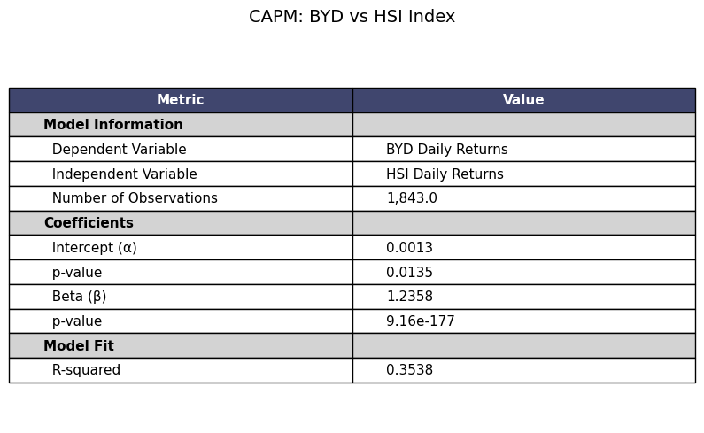
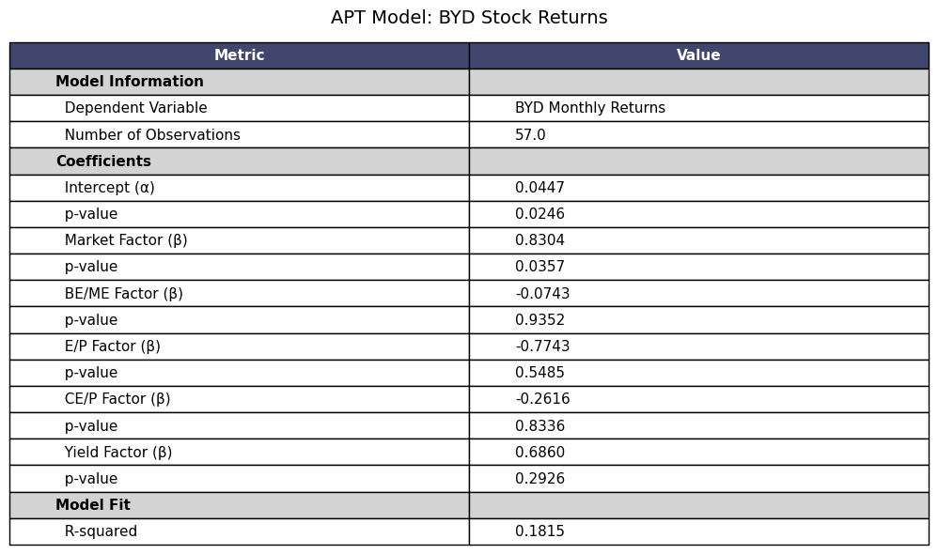
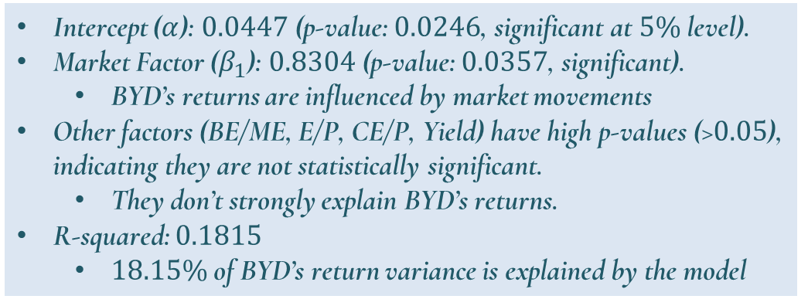
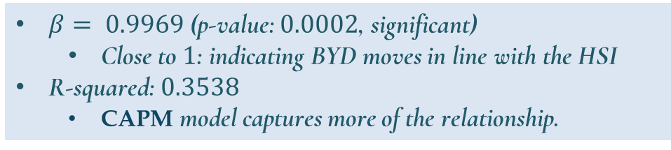

Quantitative Analysis: Market (Hang Seng Index) Impact on BYD's Share Price
$$R_{BYD}= α+ β⋅R_{market}+ ε$$
$$R_{BYD}= α+ β_{1}⋅Mkt+ β_{2}⋅BE/ME_factor+ β_{3}⋅E/P_factor+ β_{4}⋅CE/P_factor+ β_{5}⋅Yld_factor+ ε$$
$β= 0.9969$ (p-value: $0.0002$, significant)
  Close to $1$: indicating BYD moves in line with the HSI
R-squared:$0.3538$
  CAPM model captures more of the relationship.
Intercept ($α$): $0.0447$ (p-value: $0.0246$, significant at $5\%$ level).
Market Factor ($β_{1}$): $0.8304$ (p-value: $0.0357$, significant).
  BYD’s returns are influenced by market movements
Other factors (BE/ME, E/P, CE/P, Yield) have high p-values (>$0.05$), indicating they are not statistically significant.
  They don’t strongly explain BYD’s returns.
R-squared: $0.1815$
  $18.15\%$ of BYD’s return variance is explained by the model

Slide 8
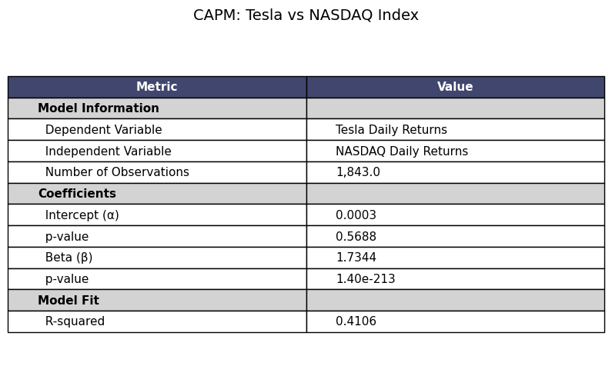

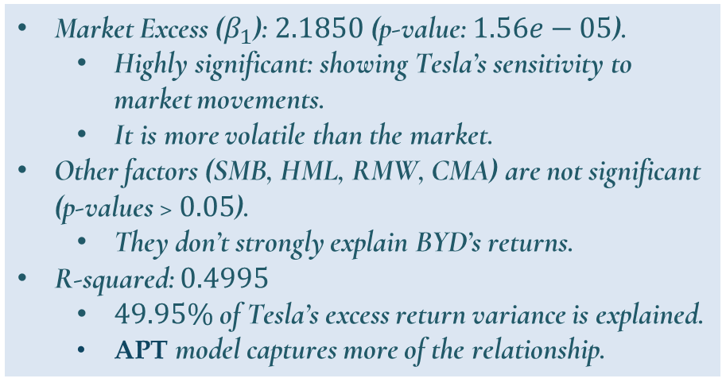
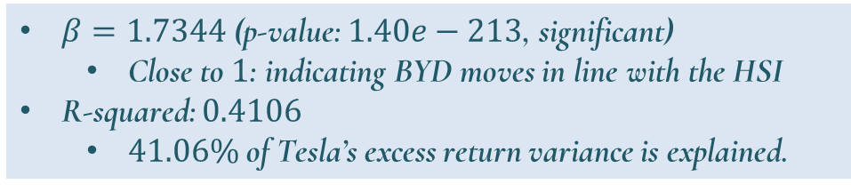

Quantitative Analysis: Market (Nasdaq) Impact on Tesla's Stock Price
$$R_{Tesla}= α+ β⋅R_{market}+ ε$$
$$R_{Tesla}− R_{f}= α+ β_{1}⋅\left(Mkt−RF\right)+ β_{2}⋅SMB+ β_{3}⋅HML+ β_{4}⋅RMW+ β_{5}⋅CMA+ ε$$
Market Excess ($β_{1}$): $2.1850$ (p-value: $1.56e−05$).
  Highly significant: showing Tesla’s sensitivity to market movements.
  It is more volatile than the market.
Other factors (SMB, HML, RMW, CMA) are not significant (p-values > $0.05$).
  They don’t strongly explain BYD’s returns.
R-squared: $0.4995$
  $49.95\%$ of Tesla’s excess return variance is explained.
  APT model captures more of the relationship.
Independent Variables:
  Market excess return (Mkt-RF).
  Size factor (SMB: Small Minus Big).
  Value factor (HML: High Minus Low).
  Profitability factor (RMW: Robust Minus Weak).
  Investment factor (CMA: Conservative Minus Aggressive).
$β=1.7344$ (p-value: $1.40e−213$, significant)
  Close to $1$: indicating BYD moves in line with the HSI
R-squared: $0.4106$
  $41.06\%$ of Tesla’s excess return variance is explained.

Slide 9
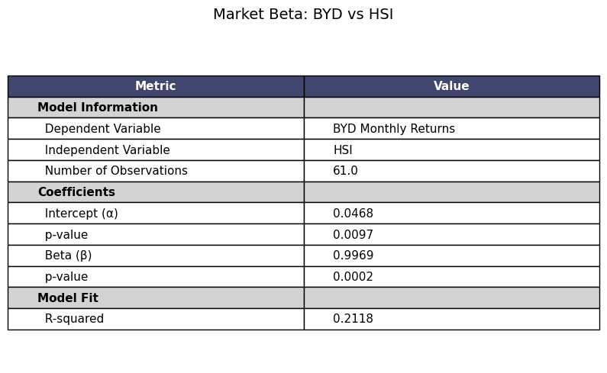
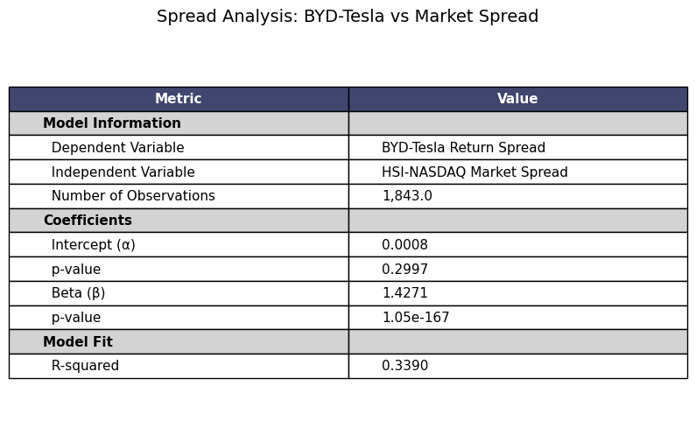
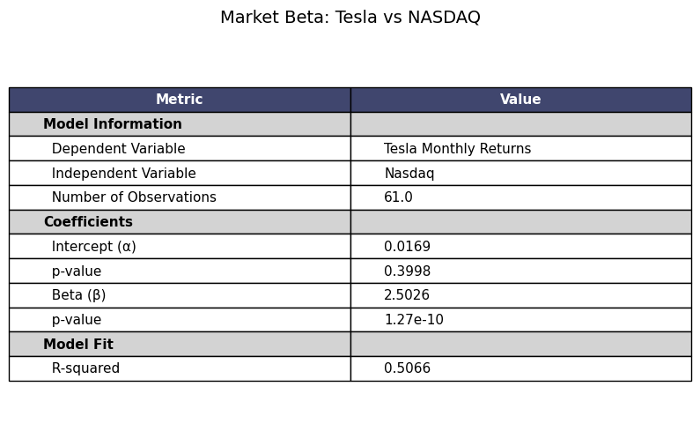
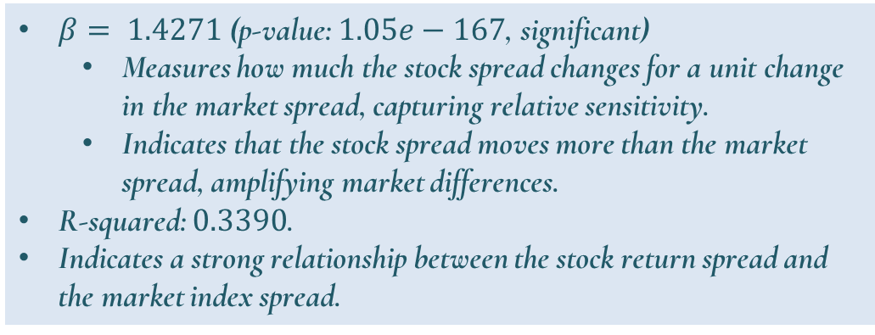
Quantitative Analysis: Market Beta Analysis
$$BYD−Tesla Spread = α+ β⋅HSI−NASDAQ Spread + ε$$
$β= 1.4271$ (p-value: $1.05e−167$, significant)
  Measures how much the stock spread changes for a unit change in the market spread, capturing relative sensitivity.
  Indicates that the stock spread moves more than the market spread, amplifying market differences.
R-squared: $0.3390$.
Indicates a strong relationship between the stock return spread and the market index spread.

